Slide 1



Module 3: Digital Systems

Slide 2


Counters
A Counter is a device which stores (and sometimes displays) the number of times a particular event or process has occurred, often in relationship to a clock signal.
Counters are used in digital electronics for counting purpose, they can count specific event happening in the circuit.
Counters are broadly divided into two categories
Asynchronous counter
Synchronous counter

Slide 3
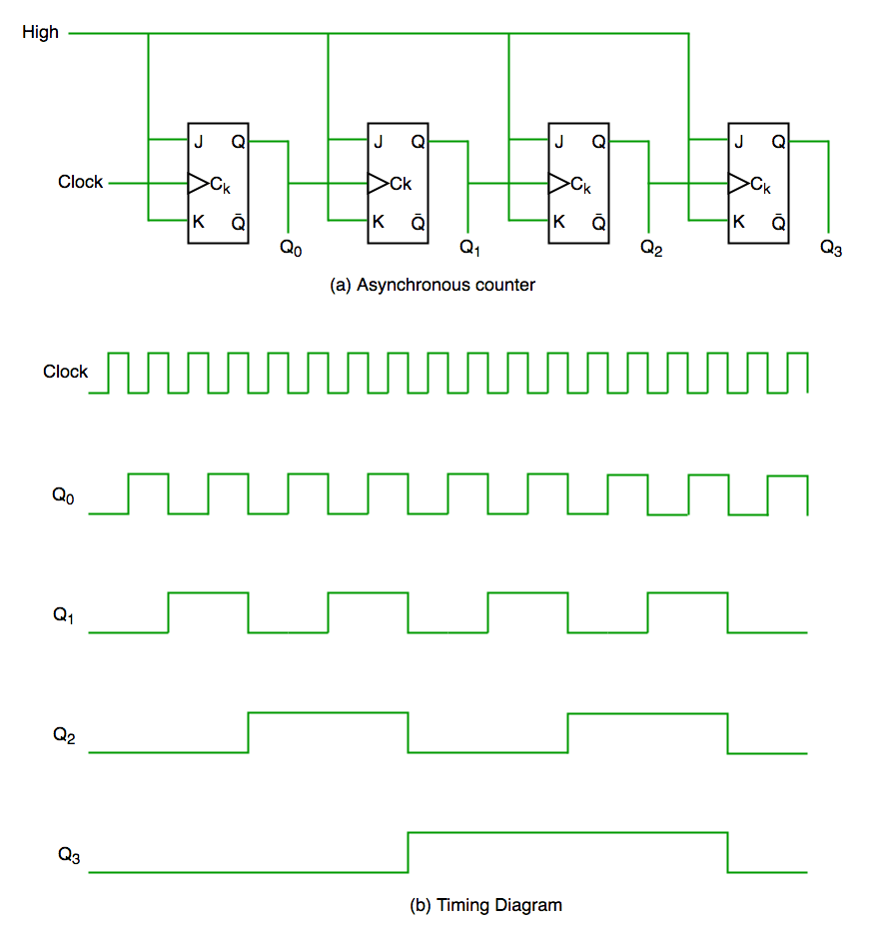













Asynchronous Counter
In asynchronous counter we don’t use universal clock, only first flip flop is driven by main clock and the clock input of rest of the following flip flop is driven by output of previous flip flops.
It is evident from timing diagram that Q0 is changing as soon as the rising edge of clock pulse is encountered, Q1 is changing when rising edge of Q0 is encountered (because Q0 is like clock pulse for second flip flop) and so on. In this way ripples are generated through Q0,Q1,Q2,Q3 hence it is also called RIPPLE counter.

Slide 4
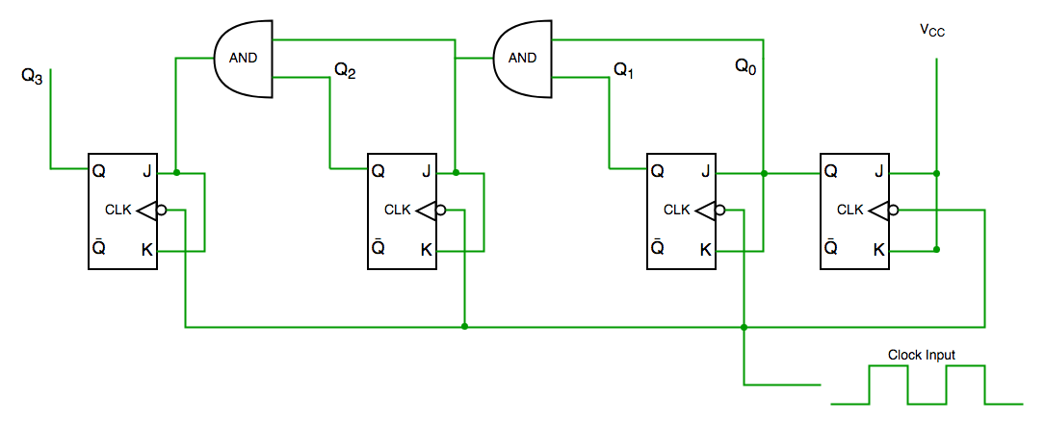






Synchronous Counter
Unlike the asynchronous counter, synchronous counter has one global clock which drives each flip flop so output changes in parallel.
The one advantage of synchronous counter over asynchronous counter is, it can operate on higher frequency than asynchronous counter as it does not have cumulative delay because of same clock is given to each flip flop.

Slide 5
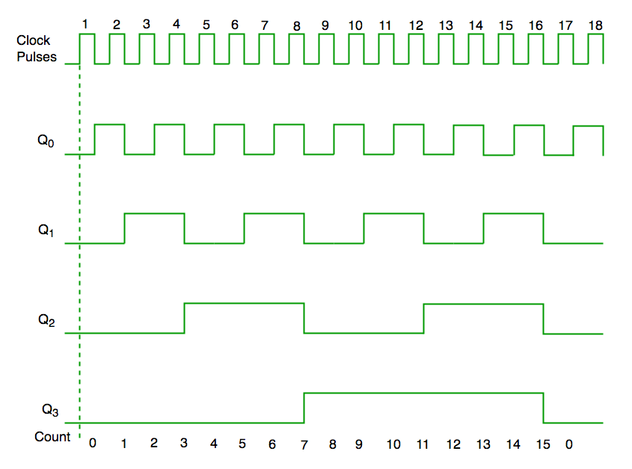




Synchronous Counter
From circuit diagram we see that Q0 bit gives response to each falling edge of clock while Q1 is dependent on Q0, Q2 is dependent on Q1 and Q0, Q3 is dependent on Q2, Q1 and Q0.

Slide 6

MCQ 1
1. In digital logic, a counter is a device which ____________
a) Counts the number of outputs
b) Stores the number of times a particular event or process has occurred
c) Stores the number of times a clock pulse rises and falls
d) Counts the number of inputs
B

Slide 7

MCQ 2
A counter circuit is usually constructed of ____________
a) A number of latches connected in cascade form
b) A number of NAND gates connected in cascade form
c) A number of flip-flops connected in cascade
d) A number of NOR gates connected in cascade form
C

Slide 8
MCQ 3
Ripple counters are also called ____________
a) SSI counters
b) Asynchronous counters
c) Synchronous counters
d) VLSI counters
B

Slide 9
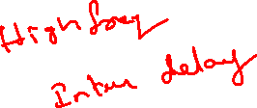
MCQ 4
One of the major drawbacks to the use of asynchronous counters is that ____________
a) Low-frequency applications are limited because of internal propagation delays
b) High-frequency applications are limited because of internal propagation delays
c) Asynchronous counters do not have major drawbacks and are suitable for use in high- and low-frequency counting applications
d) Asynchronous counters do not have propagation delays, which limits their use in high-frequency applications
B

Slide 10
MCQ 5
Internal propagation delay of asynchronous counter is removed by ____________
a) Ripple counter
b) Ring counter
c) Modulus counter
d) Synchronous counter
D

